Slide 1
Company Valuation:
1st Valuation Method
Discounted Cash Flow Valuation
Part II: Cash Flows
Damodaran on Valuation
  Measuring Earnings (ch 9)
  Earnings & Cash Flows (ch 10)
  Growth (ch 11)
Hillier Et al. (2010)
  Capital Budgeting Practices (ch 8)
Kalaitzoglou Iordanis

Slide 2
Recap: What we have seen so far
Company Valuation
DCF
Intrinsic Value
Business Oriented
Relative Valuation
Other Assets
Market Oriented
Real Options
Derivatives
Flexibility
Uncertainty
Bias
Complexity

Slide 3
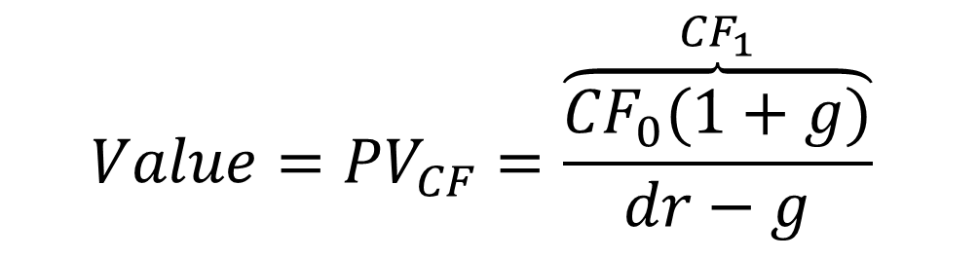
Simplest Valuation: Present value of a growing perpetuity
DCF Input I:
Which CF should I discount?
DCF Input II:
How fast do I expect this CF to grow into the future (infinity)
$$Value={PV}_{CF}=\frac{\overset{{CF}_{1}}{\overbrace{{CF}_{0}(1+g)}}}{dr−g}$$
DCF Input III:
How risky is this CF? What discount rate (dr) should I use?

Slide 4
Discounted Cash Flow Valuation: The Steps
DCF Input I:
Cash Flow
DCF Input II:
Growth
From Earnings to Cash flows
Earnings Adjustments
Re-Investment
DCF Input III:
Discount Rate
How fast do you expect CF to grow
For how long?
How many stages?
What rate reflects risk?
Equity or firm?
Adjustments (inflation, risk)
dr can vary over time
Notes:
The process is not always sequential. It may seem irrational to pick the DCF model after you have estimated the inputs, but you have to get a sense of the cash flows and growth potential before you pick a model.

Slide 5
Steps in Cash Flow Estimation
Estimate the current earnings of the firm
If looking at cash flows to equity, look at earnings after interest expenses - i.e. net income
If looking at cash flows to the firm, look at operating earnings after taxes
Consider how much the firm invested to create future growth
If the investment is not expensed, it will be categorized as capital expenditures. To the extent that depreciation provides a cash flow, it will cover some of these expenditures.
Increasing working capital needs are also investments for future growth
If looking at cash flows to equity, consider the cash flows from net debt issues (debt issued - debt repaid)
Notes:
Sets up the process. Much as we do not trust accounting statements, that is where we go for the information. Accounting earnings are not cash flows.
We do not draw a distinction between discretionary and required capital expenditures. Once you introduce growth in earnings, the distinction becomes largely symbolic.
Draws a distinction between cashflows to equity and the firm again.

Slide 6
Session Plan
Measuring Earnings
Normalize Earnings (Cyclicality-Variability)
From Earnings to Cash Flows
Tax
Correcting Earnings
Updating Earnings
Abnormal Expenses-Negative Earnings
Adjusting Operating Costs
Investment Activities-Capital Expenses
Financing Activities
Equity Income
Estimating Growth of Earnings
Firm CF
Terminal Value
NWC Investments

Slide 7
Cash Flows can be measured to
All claimholders in the firm
EBIT(1-Tax)
– (Cap Expend-Depreciation)
– Change in non-cash WC
=Free CF to Firm (FCFF)
Equity Investors
Net Income
– (Cap Expend – Depreciation)
–Change in non-cash WC
– (Principal Repaid –New Debt Issues)
– Preferred Dividend
= Free CF to Equity
(FCFE)
Dividends
+ Stock Buybacks
Notes:
Lays out the three definitions of cashflows. The strictest measure is the dividend measure. (In fact, there are some who do not count stock buybacks.) The more expansive equity measure is the free cashflow to equity, which you can think off as potential dividends. The free cashflow to the firm is the cash available for all claimholders in the firm - it is before cashflows to any of the claimholders in the firm - debt or equity.
How to calculate Cash flows. An example
http://www.wikihow.com/Calculate-Free-Cash-Flow-to-Equity
And a nice poem inspired by cash flows
http://www.irdu.nus.edu.sg/~edward/pages1/cashflow.html

Slide 8
Difficulties in Measuring Earnings:
From Reported to Actual Earnings
I.
Updating Earnings
Last available information
II.
Unusual items
One Time
Non Recurring
Negative or Abnormal
Trailing Earnings
III.
Correcting Accounting Earnings
Operating Leases/Pension Contributions
R&D Expenses
Notes:
Very seldom can you use the reported earnings in the annual report in valuation. This lays out the three adjustments that you usually have to make before you start doing valuation:
You might need to update the accounting information for most recent reports that have come from the firm or other sources.
If you have a cyclical or commodity firm, you have to adjust the earnings for where in the cycle (of the economy, for a cyclical firm, or for the commodity price, for a commodity firm) you are currently.
You have to clean up for obvious shortcomings in accounting rules.

Slide 9
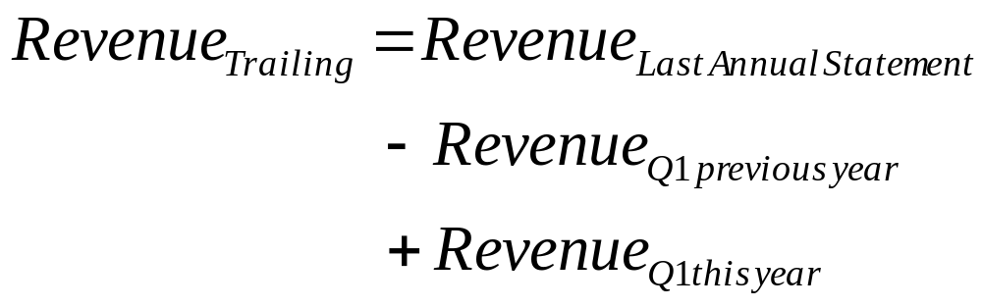
I. Update Earnings-Trailing Earnings
When valuing companies, we often depend upon financial statements for inputs on earnings and assets. Annual reports are often outdated and can be updated by using-
  Trailing 12-month data, constructed from quarterly earnings reports.
  Informal and unofficial news reports, if quarterly reports are unavailable.
Updating makes the most difference for smaller and more volatile firms, as well as for firms that have undergone significant restructuring.
Time saver: To get a trailing 12-month number, all you need is one figure from Annual and two from quarterly (semiannually) reports.
Notes:
For larger and more mature firms, you can get away with using the most recent annual report. The younger the firm and the more tumultuous the times (the economy entering a recession, for instance), the more you have to worry about using dated information.
Your objective in valuation is simple. You want to use the most recent information you can get for every input, even if it means that your inputs are observed at different points in time - the market values may be from today and the accounting information from the most recent quarterly report.

Slide 10
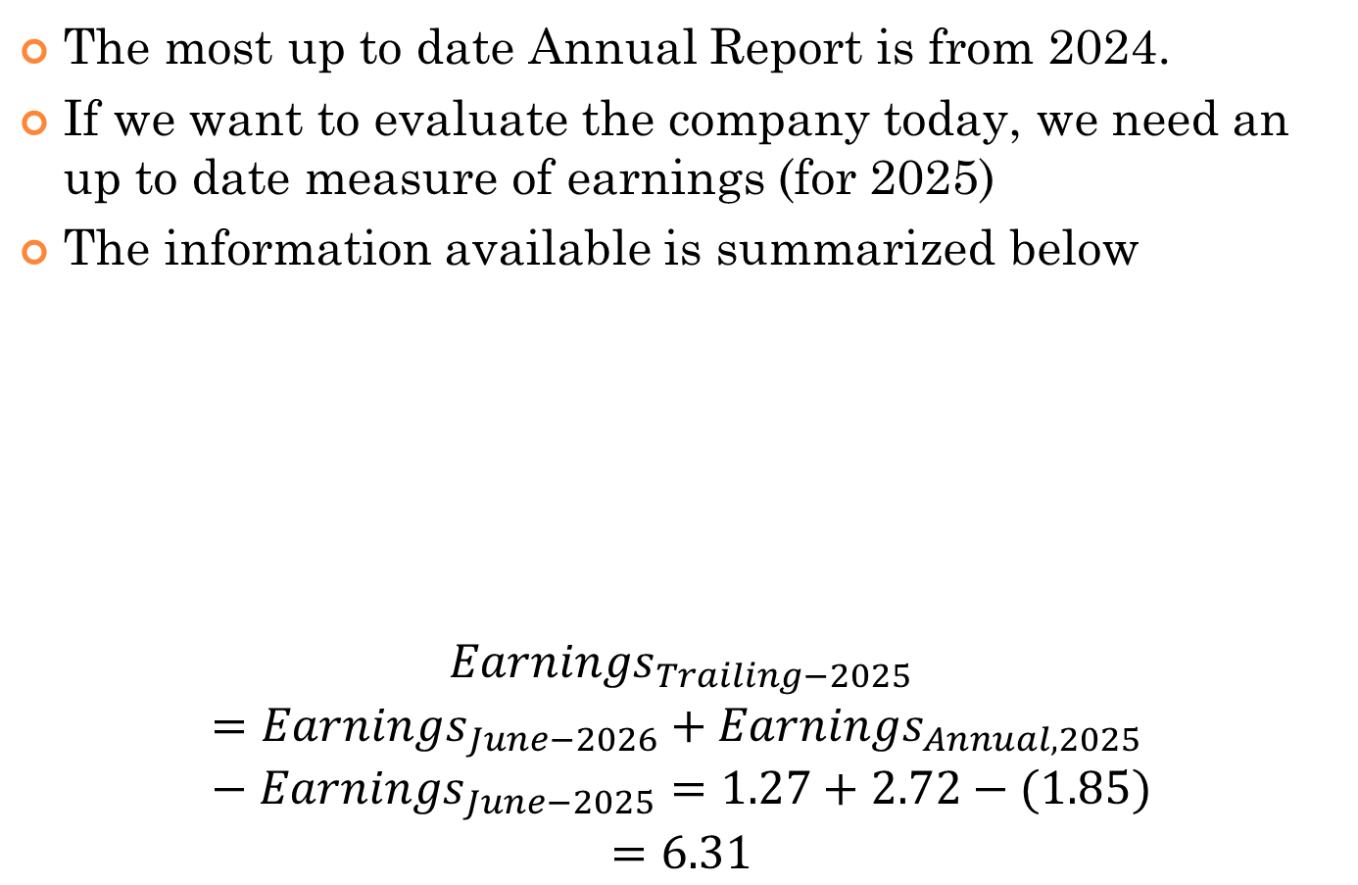
Updating Earnings Example-Disney
The most up to date Annual Report is from 2024.
If we want to evaluate the company today, we need an up to date measure of earnings (for 2025)
The information available is summarized below
$${Earnings}_{Trailing−2025}$$
$$={Earnings}_{June−2026}+{Earnings}_{Annual, 2025}−{Earnings}_{June−2025}=1.27+2.72−(1.85)$$
$$=6.31$$
Date | EPS
Q1-2026 | 1.27
Annual 2025 | 6.85
Q1-2025 | 1.85
Notes:
The information was retrieved directly from NASDAQ.
https://www.macrotrends.net/stocks/charts/DIS/disney/eps-earnings-per-share-diluted
The last reported annual earnings (October 2024) were $2.72 per share. This is a particularly challenging period for Disney. But it seems to be doing particularly well lately. The Q2 EPS (2.92) and Q1(1.81) is significantly higher than the last annual, as well as from the last year’s Q2 (1.43) and Q1(-0.01). There for this year we do expect a significantly higher EPS. At least equal to trailing earnings
With Q2: 2.92+2.72-1.43=3.21
With Q1: 1.81+2.72-(-0.01)=4.54
Instead Q1 or June, you can use the most important. For example for APPL that would be X’mas.

Slide 11

No Dividends the last years
Which Figure of EPS should we use NOW?
Probably our trailing should be more consistent than the long term trend (exponential). Maybe the Q2 trailing (3.21) is more consistent.
Notes:
The final decision is up to you and depends on your view of the company.
My view is that Disney, after some challenging years seems to be doing particularly well and earnings seem to be growing exponentially. Maybe back to the long term (pre-2020) trend. So the 4.54 might not be that unrealistic. I would go with that.

Slide 12

Do I need to Estimate Trailing Earnings for Nestle?

Slide 13

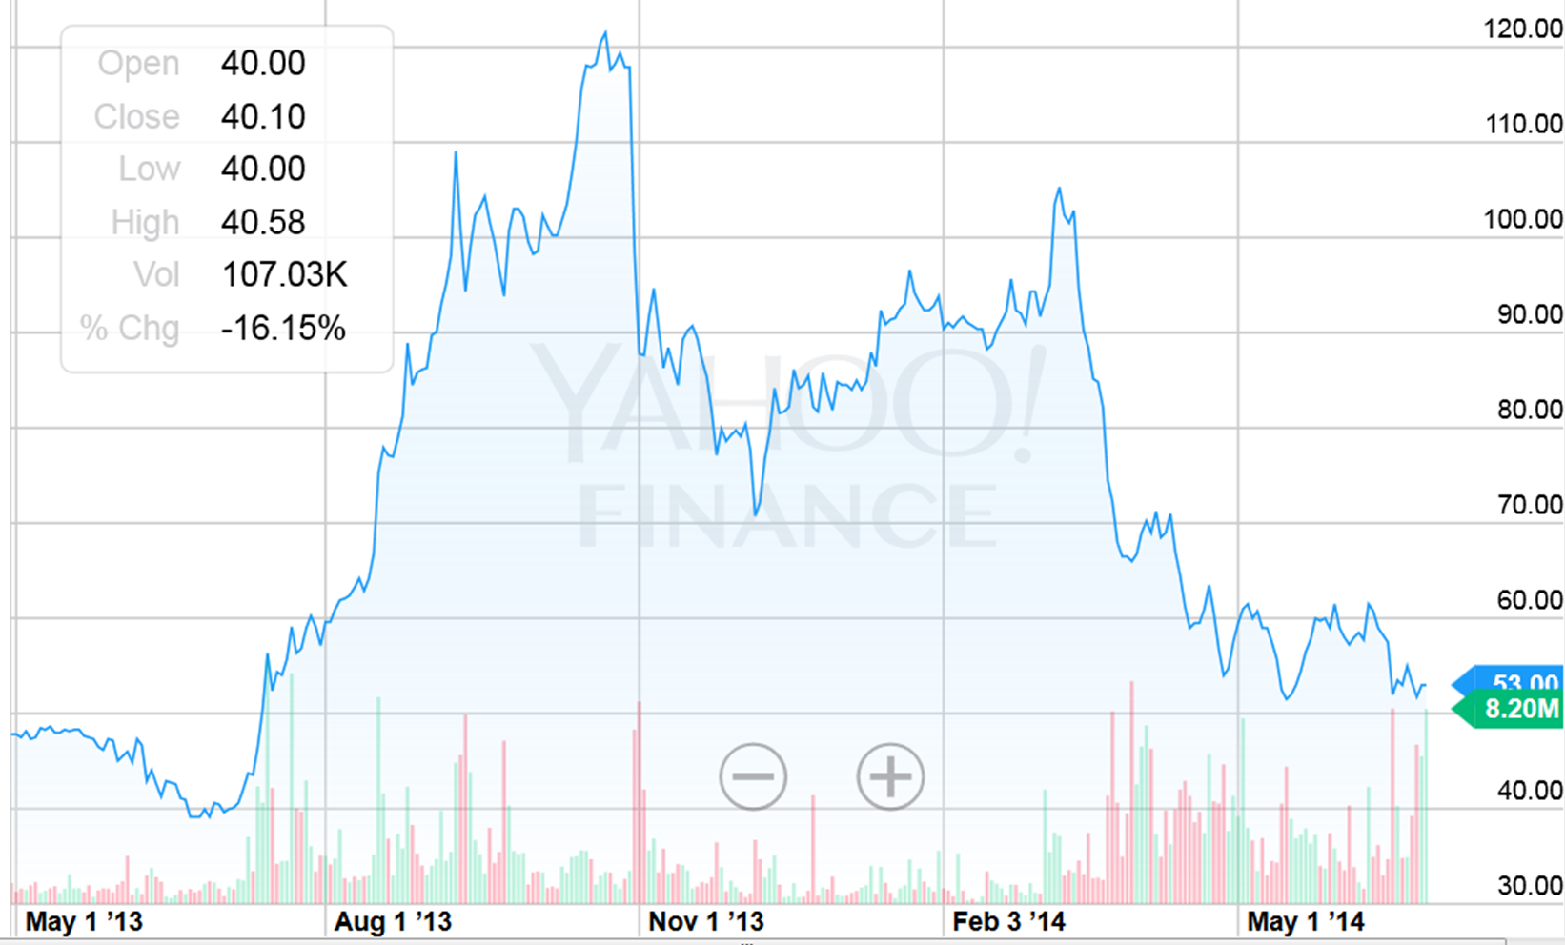
The lucky guys!!!
Share price of Premier Foods in 2013?

Slide 14

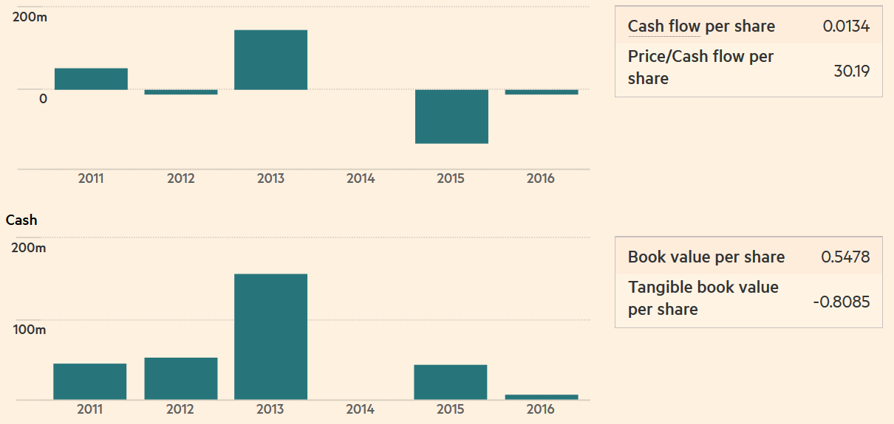
Why????
Could this be assumed to be the new norm????
Premier Foods will sell Quorn to a pension fund….

Slide 15
Other Examples?

Slide 16
II. One-Time and Non-recurring Charges: Pick Up an Example
Notes:
If it is truly a one-time change, you should use a profit of $ 500 million.
If the firm is playing games (consolidating expenses and reporting them as one-time charges every five years), you should take the average annual expense of $ 200 million (1/5 of $ 1 billion) and estimate a profit of $ 300 million.
Don’t take company characterizations of non-recurring charges at face value. Look at the firm’s history.
Some worrying signs in the financial statements p.248 in the book

Slide 17
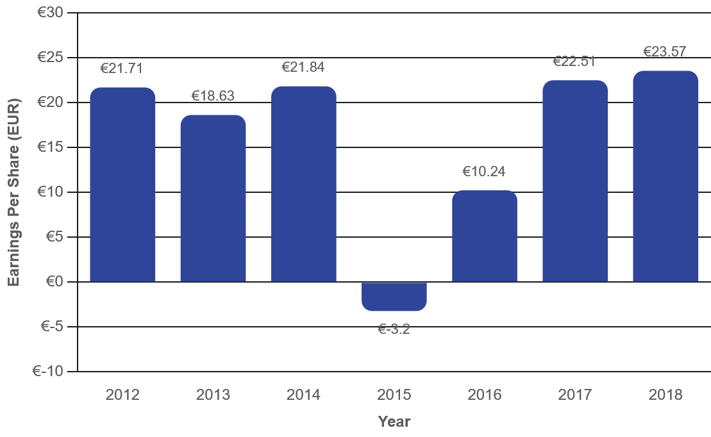
Compare and Contrast
VW-EPS
BP was forced to pay a fine for the leak in Golf of Mexico.
VW was caught on a dieselgate
Notes:
Is it really?
Some more data from Nasdaq reveal that the surprise in eps is really high. Read more: http://www.nasdaq.com/earnings/report/bp#ixzz40tTDKaQA

Slide 18
In a Nutshell: What do I Do?
My earnings are negative: What to Do?
I believe it is temporary
Average Earnings if size is stable
ROE or ROC: ${Earnings}_{t}={ROE}_{referene}∗{Equity}_{t}$ if size is not stable
ROE or ROC: 〖𝐸𝑎𝑟𝑛𝑖𝑛𝑔𝑠〗_𝑡=〖𝑅𝑂𝐸〗_𝑟𝑒𝑓𝑒𝑟𝑒𝑛𝑒∗〖𝐸𝑞𝑢𝑖𝑡𝑦〗_𝑡 if size is not stable
I believe it is not temporary ➔ Explicit Cash Flows
Target Profit Margin: if the problem is Structural
Target Debt Ratio: if Leverage is the problem
Industry Profit margin: if there are operating problems
Notes:
To decide what to do when you firm is losing money, you first have to diagnose the problem. If the problem is transitory (a short recession, a loss caused by a strike), you can normalize earnings instaneously and use the normalized earnings in valuation (Note that this might have already been done in the databases you use. Both Bloomberg and EIKON report both the raw data and the normalized data).
In a stable mature firm like Microsoft or BP, which have experienced on off negative earnings, we have reasons to believe that this will not be observed again, at least not to this extend. Therefore, we can either forecast (e.g., trendline) or take the average figure for earnings. This will be our measurement of earnings, which we expect to evolve.
In contrast, when the firm is on a developing stage, like high growth (wine distribution in China), or shrinking business (Ipod), then it would be better to identify a representative ROE or ROC ratio (this could be the average or the expected) and estimate earnings based on this. For example if BVequity is 100, ROE=10% and current EPS is -50, we can use an estimate of 10. This will be the base which we expect to evolve over time.
If it is long term, you have to first figure out what the long term problem is.
If it is financial - the firm has too much debt - you have to consider whether the firm can pay down its debt and survive. If you believe it can, lower the debt ratio each year and compute a cost of capital.
If it is operating or strategic - you have to work out what it will cost the firm to fix these problems- and build the expected improvement in margins over time.
If it is life cycle related - the firm is in early stage of its life cycle and it is normal to lose money at that stage - you have to build in the expectations of the improvements that will occur as the firm moves up the life cycle (with a healthy dose of skepticism about whether the firm will make it).
FOOD FOR THOUGHT
For further practice try to identify what is the issue with SNCF. We have seen the annual report and that it is loosing money. Do you think that it is exceptional and that it could be reversed? Do you think that we could derive a more fair estimate of earnings? In 2017 they reported positive earnings for the first time after a long time. Is this exceptional too?????

Slide 19
Should we consider an extraordinary item for nestle?

Slide 20
III. Correcting Accounting Earnings
“Advanced Financial Analysis”
Make sure that there are no financial expenses mixed in with operating expenses
  Financial expense: Any commitment that is tax deductible that you have to meet no matter what your operating results: Failure to meet it leads to loss of control of the business.
  Example: Operating Leases: While accounting convention treats operating leases as operating expenses, they are really financial expenses and need to be reclassified as such. This has no effect on equity earnings but does change the operating earnings. Pension Contributions are similar.
Make sure that there are no capital expenses mixed in with the operating expenses
  Capital expense: Any expense that is expected to generate benefits over multiple periods.
  R & D Adjustment: Since R&D is a capital expenditure (rather than an operating expense), the operating income has to be adjusted to reflect its treatment.
Notes:
Financial expense: Any commitment that is tax deductible that you have to meet no matter what your operating results: Failure to meet it leads to loss of control of the business.
Capital expense: Any expense that is expected to generate benefits over multiple periods.
These are two fairly standard adjustments you have to make to almost every firm that you encounter though the consequences are going to be larger for some firms than others.

Slide 21
Dealing with Operating Lease Expenses
Operating Lease Expenses are treated as operating expenses in computing operating income. In reality, operating lease expenses should be treated as financing expenses, with the following adjustments to earnings and capital:
When you convert operating leases into debt, you also create an asset to counter it of exactly the same value.
Adjusted Operating Earnings
  As an approximation, this works:
  Adjusted Operating Earnings = Operating Earnings + Pre-tax cost of Debt * PV of Operating Leases.
Notes:
From an intuitive standpoint, there is little difference between a term loan (where you pay off a loan in equal annual installments) and an operating lease. It may be more like unsecured debt than secured debt but it is debt.
It is not just debt that is affected when you convert operating leases to debt. The operating income also will change.
The firms where operating leases matter the most are retail firms…

Slide 22
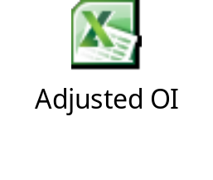
Example OL-Easyjet
Year | Maintenance Lease | Finance Lease | Total OL | Other Figures
0 | 212 | 102 | 314 | EBIT | 497
1 | 112 | 14 | 126 | Tax | 24%
2 | 297 | 121 | 418 | Interest | 23.5
3 | 297 | 121 | 418 | Debt | 592
4 | 297 | 121 | 418
5 | 297 | 121 | 418
6 | 105 | 85 | 190
7 | 105 | 85 | 190
8 | 105 | 85 | 190
9 | 105 | 85 | 190
10 | 105 | 85 | 190
What should be the change in the operating income for Easyjet?
Notes:
The annual Report for Easyjet can be found here
http://corporate.easyjet.com/~/media/Files/E/Easyjet-Plc-V2/pdf/investors/result-center-investor/annual-report-2013.pdf
Income statement p. 96
Tax p. 33. Explanation about effective and marginal tax rate and tax rate changes. We will assume a 23.5% tax rate for simplicity.
Operating Leases, note 23, p 126 and notes 8, 14 and 16.

Slide 23
Impact of Off-Balance Sheet Financing
Financial Expenses (Off-Balance Sheet Liabilities)
They Change Operating Income
They should be considered as Debt
This increases Debt, but also creates an equivalent asset
Net Income does not change due to depreciation and the increased interest payments
Cost of Capital Changes
Return on Capital Changes

Slide 24
R&D Expenses: Operating or Capital Expenses
Accounting standards require us to consider R&D as an operating expense even though it is designed to generate future growth. It is more logical to treat it as capital expenditures.
To capitalize R&D,
  Specify an amortizable life for R&D (2 - 10 years)
  Collect past R&D expenses for as long as the amortizable life
  Sum up the unamortized R&D over the period.
Notes:
The argument used by accountants - that R&D yields uncertain benefits - is specious. You could make the same argument about other investments - investing in a factory in an emerging market, deciding to build a concept car - and you are forced to treat these as capital expenditures.
To capitalize R&D, you need to specify
On average, how long it takes between the time you do research and a commercial product emerges from the research. (This is the amortizable life)
R&D expenses from the past (for a period equivalent to the amortizable life). If your firm has not been in existence for that long, you would go back for as many years as you can.
Depreciation schedules - stick with the simplest which is straight line depreciation.
For example assuming that the amortizable life is 5 ys, the research asset can be obtained by adding up 1/5th of the R&D expense from five years ago, 2/5th of the R&D expense from four years ago...: for details check the net slide.

Slide 25
Impact of Off-Balance Sheet Investments
Capital Investments (Off-Balance Sheet Assets)
They Change Operating Income
They should be considered as an Intangible Asset
This increases Fixed Assets, but also creates an equivalent value for Equity
They Change Net Income (The asset increases Equity. No Interest Payments)
Cost of Capital Changes
Return on Capital Changes
They Are Investments
They increase CapEx
They Increase growth

Slide 26
From Earnings To
Actual Cash Flows
A.
Tax
B.
Net Capital Expenditures
C.
NWC Investments

Slide 27
A.
TAX
EBIT ( 1 - tax rate)
- (Capital Expenditures - Depreciation)
- Change in Working Capital
= Cash flow to the firm
Where are the tax savings from interest payments in this cash flow?
In the discount rate!
!!!Otherwise the cancel out!!!
Notes:
The tax savings from interest payments do not show up in the cashflows because they have already been counted in the cost of capital (in the use of the after-tax cost of debt). If you add the interest tax benefits to the cashflows, you will double count the benefit.
Please read this short definition that might help
http://www.investinganswers.com/financial-dictionary/financial-statement-analysis/net-operating-profit-after-tax-nopat-2820

Slide 28
What Tax Rate? Choose Wisely
Marginal
Cost of next $
Regulation
Effective
Forecastable
Actual CF
Tax optimization
Reported by government
Reported in statements
Notes:
The choice is between the effective and the marginal tax rate. In doing projections, it is far safer to use the marginal tax rate since the effective tax rate is really a reflection of the difference between the accounting and the tax books.
By using the marginal tax rate, we tend to understate the after-tax operating income in the earlier years, but the after-tax tax operating income is more accurate in later years
If you choose to use the effective tax rate, adjust the tax rate towards the marginal tax rate over time.
While an argument can be made for using a weighted average marginal tax rate, it is safest to use the marginal tax rate of the country
If you have a choice, you would prefer to do valuation with the tax books in front of you, but since you do not have that choice as an outsider you have to choose between the effective tax rate and the marginal tax rate.
If you use the effective tax rate all the way through, you are assuming that taxes can be deferred forever. This is unrealistic - tax deferrals catch up with you as your growth flags - and will result in an overvaluation of your firm.
If you use a marginal tax rate, you are assuming that you cannot defer taxes from this point on. This is far too conservative and will yield too low a value for your firm.
Suggestion: Start with the effective tax rate in the early years and move towards the marginal tax rate in the terminal year.
From a theory point of view the most appropriate is the marginal tax rate because it represents the tax liability on each additional dollar (assuming that the firm is growing).
However, this might be highly complicated in various situations, such as:
Countries with complicated structure of tax liabilities and credits, such as Germany or France
Small firms, with income below the top tax bracket. The marginal rate should be expected to change
Firms that pursue an active tax optimization policy, such as deferring earnings.
Firms with past large operating losses
Firms with large operating leases.
In these cases, it might be better to use a proxy of the marginal rate that better reflects the current situation (the effective rate) and adjust it (if necessary) over the years towards the marginal rate.

Slide 29
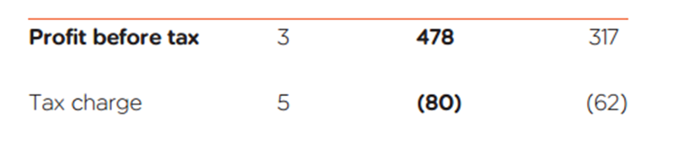
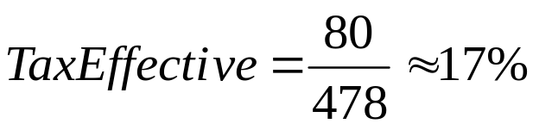
Easyjet Tax rate
“The signiﬁcant majority of proﬁts are subject to UK corporation tax at 23.5%; the remainder being subject to Swiss corporate tax at 24.1%. The lower effective tax rate of 17% is a consequence of legislation being enacted in the year reducing the UK corporation tax rate to 20% from 1 April 2015, which resulted in a reduction of the deferred tax element of the tax liability.”
Rate | 2011 | 2012 | 2013 | 2014 | 2015
Small profits rate* | 20%* | 20%* | 20%* | 20%* | 15%*
Main rate of Corporation Tax* | 26%* | 24%* | 23%* | 21%* | 17%*
Notes:
Data taken from
Annual Report Easyjet 2013 p. 94 and 31
http://corporate.easyjet.com/~/media/Files/E/Easyjet-Plc-V2/pdf/investors/result-center-investor/annual-report-2013.pdf
And
http://www.hmrc.gov.uk/rates/corp.htm

Slide 30
A Tax Rate for a Money Losing Firm
Does this remind you of somebody???
Assume that you are trying to estimate the after-tax operating income for a firm with $ 1 billion in net operating losses carried forward. This firm is expected to have operating income of $ 500 million each year for the next 3 years, and the marginal tax rate on income for all firms that make money is 40%. Estimate the after-tax operating income each year for the next 3 years.
Year 1 Year 2 Year 3
EBIT 500 500 500
Taxes
EBIT (1-t)
Tax rate
Notes:
Emphasizes the importance of NOLs. The tax rate will be zero in the first two years and will be 40% in the third year.
(Suggestion: Change the first year to a loss of $ 500 million, the third year to a profit of $ 1 billion and work out the solution. The NOL will increase to $1.5 billion after year 1 and cover income in years 2 and 3.)

Slide 31
B.
Net Capital Expenditures (NCE)
NCE’s represent the difference between capital expenditures and depreciation.
Depreciation is a cash inflow that pays for some CAPEX.
In general, the net capital expenditures will be a function of how fast a firm is growing or expecting to grow.
High growth firms will have much higher net capital expenditures than low growth firms.
Assumptions about net capital expenditures can never be made independently of assumptions about growth in the future.
Notes:
It is dangerous to have three separate (and unconnected) line items for capital expenditures, depreciation and growth in a valuation. Analysts very quickly discover the secret of value creation (at least on paper) - decrease cap ex, increase depreciation and increase growth.
Capital expenditures should include
Tangible and Intangible
Research and development expenses, once they have been re-categorized as capital expenses. The adjusted net cap ex will be
Adjusted Net Capital Expenditures = Net Capital Expenditures + Current year’s R&D expenses - Amortization of Research Asset
Acquisitions of other firms, since these are like capital expenditures. The adjusted net cap ex will be
Adjusted Net Cap Ex = Net Capital Expenditures + Acquisitions of other firms - Amortization of such acquisitions
Two caveats:
1. Most firms do not do acquisitions every year. Hence, a normalized measure of acquisitions (looking at an average over time) should be used
2. The best place to find acquisitions is in the statement of cash flows, usually categorized under other investment activities
The accounting definition of cap ex is too narrow. It excludes external cap ex (which is what acquisitions are) and intangible cap ex (which is what R&D is).
We would include all acquisitions, including stock swaps acquisitions. To those who would argue that there is no cashflow associated with stock swaps, we would suggest that all that has occurred is that the firm has just skipped a step - the firm could have issued the stock to the market and used the cash on the acquisitions.
It is true that incorporating acquisitions into valuation can be messy for firms that do relatively few and very diverse acquisitions over time. You have the option of ignoring these acquisitions when you do valuation but make sure that the expected growth rate in earnings does not then include the expected growth from acquisitions. You are implicitly assuming that acquisitions in the future will be done at fair value and hence have no value impact.
Disney p. 42 and 43. This is an excellent example of annual reports, where the company reports the figures segment in different sectors.
http://cdn.media.ir.thewaltdisneycompany.com/2011/annual/WDC-10kwrap-2011.pdf

Slide 32
C.
Net Working Capital Investments
Increase in Sales needs financing.
Short term financing is provided by investments in NWC
Changes in non-cash working capital from year to year are volatile.
A far better estimate of non-cash working capital needs, is a rate of non-cash ΔNWC as a proportion of revenues
Some firms have negative non-cash working capital. (Tesco) Assuming that this will continue into the future will generate positive cash flows for the firm.
While this is indeed feasible for a period of time, it is not forever. Thus, it is better that non-cash working capital needs be set to zero, when it is negative.
Notes:
Working Capital Investments
In accounting terms, the working capital is the difference between current assets (inventory, cash and accounts receivable) and current liabilities (accounts payables, short term debt and debt due within the next year)
A cleaner definition of working capital from a cash flow perspective is the difference between non-cash current assets (inventory and accounts receivable) and non-debt current liabilities (accounts payable)
Any investment in this measure of working capital ties up cash. Therefore, any increases (decreases) in working capital will reduce (increase) cash flows in that period.
When forecasting future growth, it is important to forecast the effects of such growth on working capital needs, and building these effects into the cash flows.
We remove cash from current assets because cash is not a wasting asset for most firms with substantial cash balances. Cash today tends to be invested in treasuries or commercial paper which yields a fair return for the risk taken (which is little or none). There are some analysts who still use operating cash (which they estimate as a percent of revenues) as part of working capital, but we believe that this is no longer appropriate for firms in markets with well developed banking systems and investment alternatives.
The debt in current liabilities is included in the debt used for cost of capital.
Firms like Walmart have been able to generate cashflows by keeping non-cash working capital low or negative - in a sense, supplier credit is being used a source of capital. The possible downside is that you can increase credit risk if it gets out of control. That is why you should not assume negative non-cash working capital in perpetuity.

Slide 33
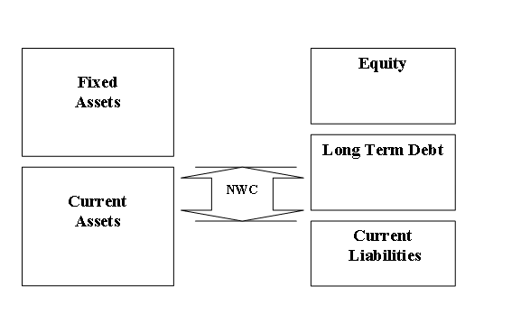
What can we learn from the BS
Liquidity
Investments
Funding

Slide 34
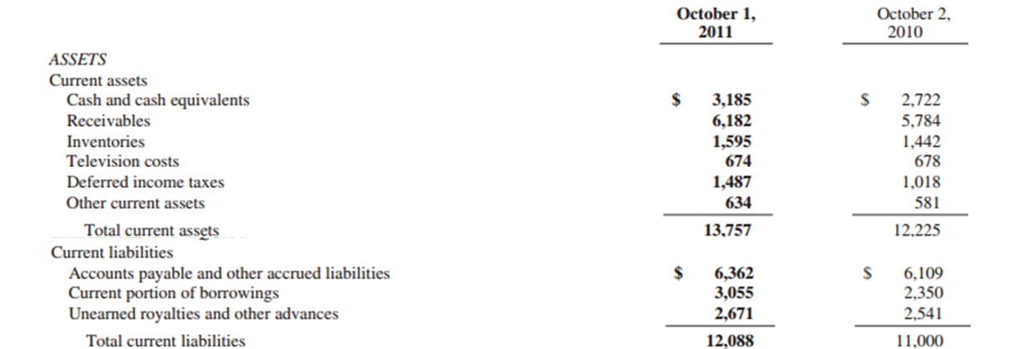
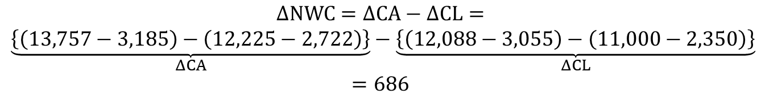
ΔWC-Example Disney
The change on non-cash NWC is
This means that we need-invest cash
$$ΔNWC=ΔCA−ΔCL=$$
$$\underset{ΔCA}{\underbrace{\left\{\left(13,757−3,185\right)−\left(12,225−2,722\right)\right\}}}−\underset{ΔCL}{\underbrace{\left\{\left(12,088−3,055\right)−\left(11,000−2,350\right)\right\}}}$$
$$=686$$

Slide 35
Example: Volatile Working Capital? What to Choose
 | Amazon | Cisco | Motorola
Revenues | $ 1,640 | $12,154 | $30,931
Non-cash WC | -419 | -404 | 2547
% of Revenues | -25.53% | -3.32% | 8.23%
Δfrom last year | ($309) | ($700) | ($829)
Avg: 3 years | -15.16% | -3.16% | 8.91%
Avg: industry | 8.71% | -2.71% | 7.04%
Assumption in Valuation
WC % of Reven | 3.00% | 0.00% | 8.23%
Notes:
In each case, we have used both the company’s history and the industry averages as the basis for our forecasts for the future. The advantage of linking working capital to revenues is that eliminates the need to estimate working capital as a separate line item.
There are some analysts who prefer to estimate each item in working capital separately - inventory, accounts receivable and accounts payable. We would do this only
If we had a strong basis for separating the items and a way of forecasting each individually.
For the short term. As you push out into future years, you are better off estimating aggregate rather than individual numbers.

Slide 36
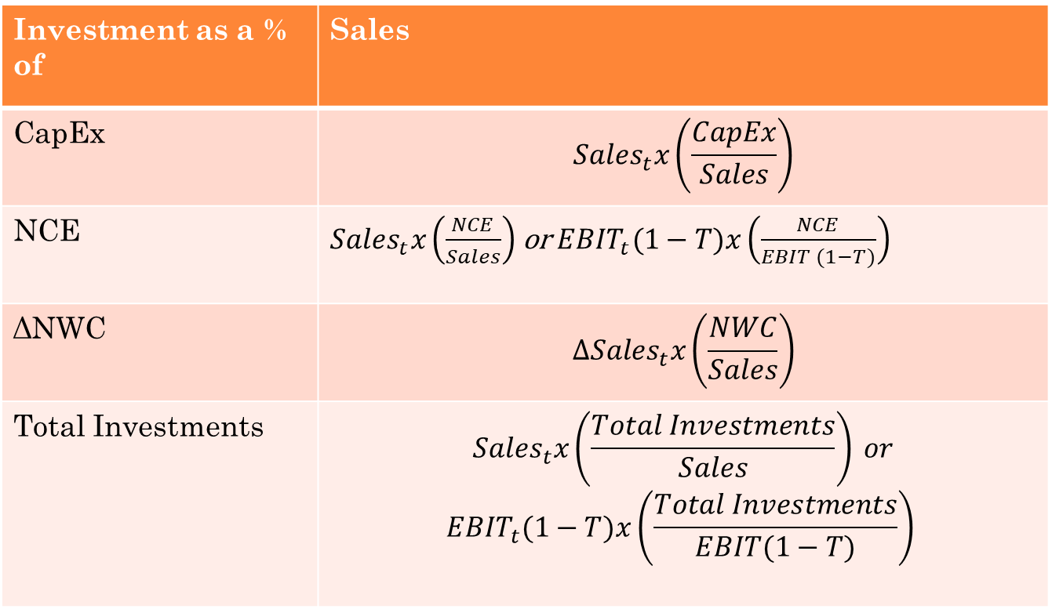
What Happens When Investments Are Volatile? Preferred Method
We can use standardized measures (Examples)
Investment as a % of | Sales
CapEx | $${Sales}_{t}x\left(\frac{CapEx}{Sales}\right)$$
NCE | ${Sales}_{t}x\left(\frac{NCE}{Sales}\right)$or ${EBIT}_{t}(1−T)x\left(\frac{NCE}{EBIT (1−T)}\right)$
ΔNWC | $${ΔSales}_{t}x\left(\frac{NWC}{Sales}\right)$$
Total Investments | $${Sales}_{t}x\left(\frac{Total Investments}{Sales}\right) or$$ $${EBIT}_{t}(1−T)x\left(\frac{Total Investments}{EBIT(1−T)}\right)$$
Notes:
In several cases it is hard to estimate the investments in either CapEx or NWC because they are volatile or because we have partial information. A workaround for this is to use some standardized measures. For example, some times it is more rational to assume that a firm will continue to invest (let s say) 30% of sales in new projects, rather than saying that they will always invest $1m (can be assumed to grow).
The first case is more homogenous on an industry level and timewise. It is like saying that I aspire achieving a target figure for sales. For this I need to make an investment. How much should I invest? An average estimate over the last years, or a reference from a “normal” period, or an industry average/target, etc.
After we estimate the reference ration (for example total investments are 50% of sales), then I should consider for every annual figure of sales (in the future) a 50% total investment.

Slide 37
Dividends and Cash Flows to Equity
In the strictest sense, the only cash flow that an investor will receive from an equity investment in a publicly traded firm is the dividend that will be paid on the stock.
Actual dividends, however, are set by the managers of the firm and may be much lower than the potential dividends (that could have been paid out)
  managers are conservative and try to smooth out dividends
  managers like to hold on to cash to meet unforeseen future contingencies and investment opportunities
When actual dividends are less than potential dividends, using a model that focuses only on dividends will under state the true value of the equity in a firm.
Notes:
In the strict view of the world, even stock buybacks are not cashflows to equity investors because they go to someone else - a person cannot sell their stock back to the company and hold it for dividends at the same time.
In 2000, US companies paid out about 60% of what was available to be paid out (after reinvestment and debt payments) in dividends. Historically, the unwillingness of managers to cut dividends has also made them more reluctant to increase dividends as earnings increase.

Slide 38
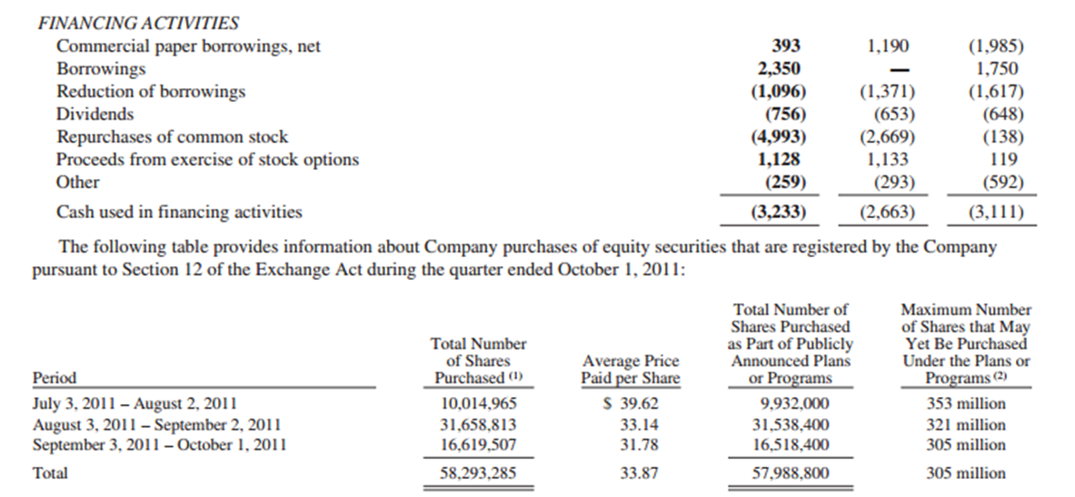
Dividends and SBB-Disney
“The Company paid a $0.40 per share dividend ($756 million) during the second quarter of fiscal 2011 related to fiscal 2010. The Company paid a $0.35 per share dividend ($653 million) during the second quarter of fiscal 2010 related to fiscal 2009; and paid a $0.35 per share dividend ($648 million) during the second quarter of fiscal 2009 related to fiscal 2008. As of the filing date of this report, the Board of Directors had not yet declared a dividend related to fiscal 2011.
During fiscal 2011, the Company repurchased 135 million shares of Disney common stock for $5.0 billion. During fiscal 2010, the Company repurchased 80 million shares of Disney common stock for $2.7 billion. During fiscal 2009, the Company repurchased 5 million shares of Disney common stock for $138 million. On March 22, 2011, the Company’s Board of Directors increased the amount of shares that can be repurchased to 400 million shares as of that date. As of October 1, 2011, the Company had remaining authorization in place to repurchase 305 million additional shares.”
Notes:
The figures are taken from the annual report p. 24 and the cash flow statement p. 63
http://cdn.media.ir.thewaltdisneycompany.com/2011/annual/WDC-10kwrap-2011.pdf

Slide 39
Measuring Potential Dividends
Some analysts assume that the earnings of a firm represent its potential dividends. This cannot be true for several reasons:
Earnings are not cash flows, since there are both non-cash revenues and expenses in the earnings calculation
Even if earnings were cash flows, a firm that paid its earnings out as dividends would not be investing in new assets and thus could not grow
Valuation models, where earnings are discounted back to the present, will over estimate the value of the equity in the firm
The potential dividends of a firm are the cash flows left over after the firm has made any “investments” to create future growth and net debt repayments (debt repayments - new debt issues)
The common categorization of capital expenditures into discretionary and non-discretionary loses its basis when there is future growth built into the valuation.
Notes:
Important note
Models that discount earnings and assume a growth rate in earnings at the same time will systematically overvalue companies because they assume that firms can grow earnings without any reinvestment. (Glassman and Hassett made this mistake in their book Dow 36000, where the discounted earnings at close to the riskfree rate and assumed real growth in perpetuity.)

Slide 40
Estimating Cash Flows: FCFE
Cash flows to Equity for a Levered Firm
  Net Income
  - (Capital Expenditures - Depreciation)
  - Changes in non-cash Working Capital
  - (Principal Repayments - New Debt Issues)
  = Free Cash flow to Equity
When Leverage is Stable:
  Net Income
  - (1- δ) (Capital Expenditures - Depreciation)
  - (1- δ) Working Capital Needs
  = Free Cash flow to Equity
  δ = Debt/Capital Ratio
Financing Activities are the same every year
Notes:
General Approach
Note the differences between this and Free cashflow to firm:
Start with net income (equity earnings) rather than operating earnings. Interest expenses are subtracted out from earnings and the tax benefits are reflected.
Net out net debt payments. If a firm raises more new debt than it pays off, this can be a positive number which, if large enough can make the free cashflow to equity higher than the free cashflow to the firm.
Important Note
I have ignored preferred dividends. If preferred stock exist, preferred dividends will also need to be netted out after Financing activities
When leverage is steady:
In computing FCFE, the book value debt to capital ratio should be used when looking back in time but can be replaced with the market value debt to capital ratio, looking forward.
This is a steady state equation and works if the firm is at a debt ratio that it feels that it can maintain for the foreseeable future.
When this equation is used to estimate free cashflows to equity in the past, the average book debt to capital ratio has to be used. The free cashflows to equity each year will be different from the actual numbers, but the averages will converge.
For this firm,
Proceeds from new debt issues = Principal Repayments + (Capital Expenditures - Depreciation + Working Capital Needs)
Leverage and Cash Flows
Let s remind ourselves what happens to cost of capital when D/E ratio increases.
Leverage, FCFE and Value
In a discounted cash flow model, increasing the debt/equity ratio will generally increase the expected free cash flows to equity investors over future time periods and also the cost of equity applied in discounting these cash flows. Which of the following statements relating leverage to value would you subscribe to?
Increasing leverage will increase value because the cash flow effects will dominate the discount rate effects
Increasing leverage will decrease value because the risk effect will be greater than the cash flow effects
Increasing leverage will not affect value because the risk effect will exactly offset the cash flow effect
Any of the above, depending upon what company you are looking at and where it is in terms of current leverage
Any of the above, if you believe that value can be affected by leverage and that there is an optimal debt ratio.
The third choice if you are a true believer in Miller-Modigliani.
As the debt ratio increases, equity investors are putting in less of the required reinvestment each year, which will push up the free cashflow to equity. This is based upon changing the debt ratio only on new investment. If you change the total debt ratio for the firm on existing assets, there will be higher interest expense and lower net income (but also fewer shares outstanding).
But the higher leverage increases the beta (levered) for the firm as well.

Slide 41
Estimating FCFE vs Dividends: Disney (Example from 1997)
Net Income=$ 1533 Million
Capital spending = $ 1,746 Million
Depreciation = $ 1,134 Million
Increase in non-cash working capital = $ 477 Million
Debt to Capital Ratio = 23.83%
Estimating FCFE:
  Net Income $1,533 Mil
  - (Cap. Exp - Depr)*(1-DR) $465.90 [(1746-1134)(1-.2383)]
  Chg. Working Capital*(1-DR) $363.33 [477(1-.2383)]
  = Free CF to Equity $ 704 Million
  Dividends Paid $ 345 Million

Slide 42
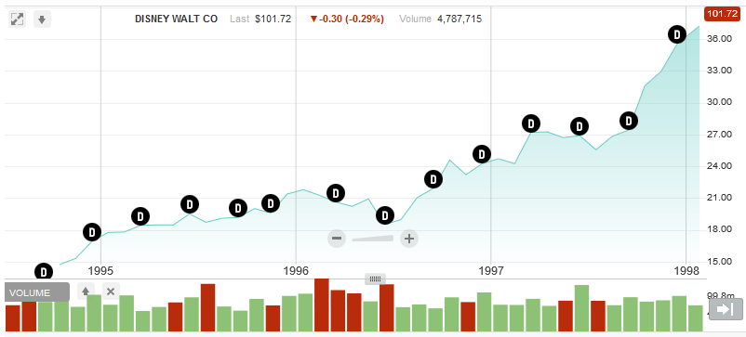
Disney was investing for growth and share price was going up (Despite the low Dividend
Notes:
Dividend cuts
A blessing or a curse?
http://www.bankrate.com/finance/investing/what-to-do-when-companies-cut-dividends-1.aspx
http://people.opposingviews.com/happens-company-cuts-its-dividends-8208.html
http://www.telegraph.co.uk/finance/personalfinance/investing/shares/12129790/In-charts-what-happens-to-share-prices-after-a-dividend-cut.html

Slide 43
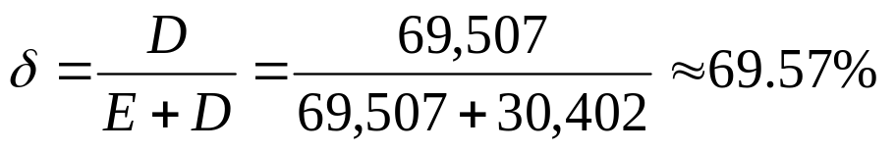
Estimate FCFs for BMW
Values | In €m
EBIT | 8,300 | Net Profit | 5,122
CapEx | 5,240 | Debt | 69,507
Depreciation | 3,541 | Equity | 30,402
ΔNWC | 1,755 | Tax | 15.8%
CASH FLOWS
EBIT(1-T) | 8,300(1-0.158) | Net Profit | 5,122
-(CapEx-Dep) | (5,240-3,541) | -(1-δ)(CapEx-Dep) | (1-0.6957) (5,240-3,541)
- (ΔNWC) | 1,755 | -(1-δ)(ΔNWC) | (1-0.6957) 1,755
FCFF | 3,534.6 | FCFE | 4,070.95
Notes:
Annual Report can be found here
http://annual-report2012.bmwgroup.com/bmwgroup/annual/2012/gb/English/pdf/report2012.pdf
Debt = Short term and long term financial liabilities. Pages 80.
Information about the company p.5 and 178 (Cap EX, EBIT, Dep)
p.82 changes in NWC
p. 102 Tax

Slide 44
FCFF and FCFE for Nestle
Actual Figures
Industry Multiple (Damodaran)
Average Multiple
Forecast/normalize figures
Forecast/normalize multiples

Slide 45
Simplest Valuation: Present value of a growing perpetuity
DCF Input I:
Which CF should I discount?
DCF Input II:
How fast do I expect this CF to grow into the future (infinity)
$$Value={PV}_{CF}=\frac{\overset{{CF}_{1}}{\overbrace{{CF}_{0}(1+g)}}}{dr−g}$$
DCF Input III:
How risky is this CF? What discount rate (dr) should I use?

Slide 46
Ways of Estimating Growth in Earnings
Look at the past
The historical growth in earnings per share is usually a good starting point for growth estimation
Look at what others are estimating
Analysts estimate growth in earnings per share for many firms. It is useful to know what their estimates are.
Look at fundamentals
Ultimately, all growth in earnings can be traced to two fundamentals - how much the firm is investing in new projects, and what returns these projects are making for the firm.
Notes:
Three basic approaches for estimating growth. We tend to use all three but the degree to which we weight each in will depend upon the company that we are looking at.

Slide 47
I. Historical Growth in EPS
Estimation
Arithmetic versus Geometric Averages
Simple versus Regression Models
Sensitive to
the period used in the estimation
Other Factors
how to deal with negative earnings
the effect of changing size
Notes:
The discussion here is similar to the market risk premium. Forecasting of figures, based on past information, is always based on the assumption that past will repeat its self.
Estimating historical growth rates may seem to be trivial, but there are a number of estimation issues that can lead different analysts to estimate different historical growth rates for the same firm.
Arithmetic Average and Regression
Arithmetic and geometric growth rates can be very different. However, the differences are widest when there is significant volatility in the year-to-year numbers - compare net income to EBIT to revenues.
When will the two converge?
Where there is no standard deviation in percent changes.
In addition, the regression approaches look more sophisticated than the arithmetic and geometric averages. You can think of the regression as yielding the arithmetic average growth rate and the second (using natural logs) as yielding the geometric average growth rate.
Depending on the figure you want to forecast, the trends in the data and the market characteristics, each method can be preferred in various situations. Simple averages are simpler to estimated and better when figures tend to return to the same value on the long term. Geometric means are more sophisticated and work better when there are seasonal trends. Finally, regressions are even more sophisticated and complicated and try to incorporate both approaches described above. They should be the preferred choice when there are many foreseeable factors that are known to affect forecasted values.

Slide 48
Apple Earnings: Historical Forecast
Notes:
Data taken from Nasdaq. Details on the same file with Disney and Microsoft.

Slide 49
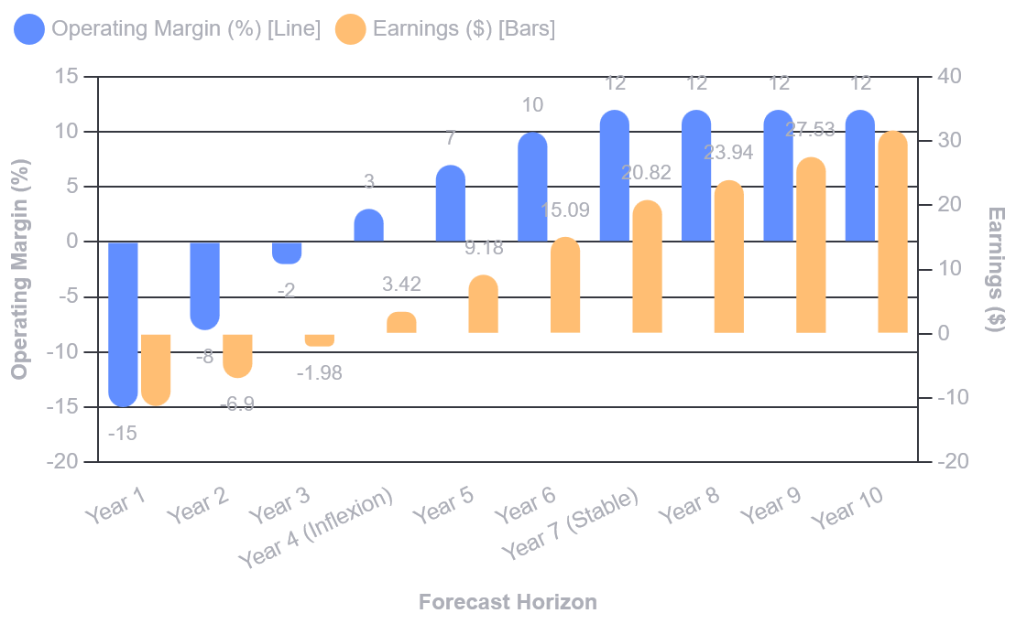
A special Mention: Negative Earnings
Forecast OPM till it becomes stable (industry)
Forecast explicitly the Earnings until that point
Then assume a growing perpetuity (linear stable growth)
Notes:
It cannot be estimated. You can modify the equation to yield a number - see next page - but it would be meaningless for making forecasts.
Dealing with Negative Earnings
When the earnings in the starting period are negative, the growth rate cannot be estimated. (0.30/-0.05 = -600%)
There are three solutions:
Use the higher of the two numbers as the denominator (0.30/0.25 = 120%)
Use the absolute value of earnings in the starting period as the denominator (0.30/0.05=600%)
Use a linear regression model and divide the coefficient by the average earnings.
When earnings are negative, the growth rate is meaningless. Thus, while the growth rate can be estimated, it does not tell you much about the future.
There are mechanical fixes that might need to be employed to come up with a number, but you should not read too much into that number.

Slide 50
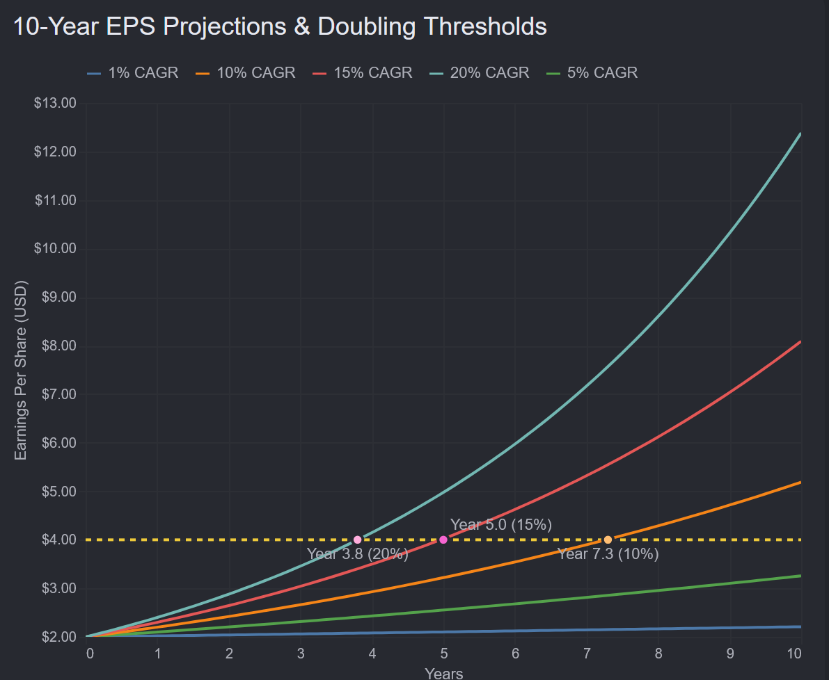
Special Mention II: Growth and Size
Companies can grow fast, but not forever. Make sure that your assumptions make sense

Slide 51
II. Analyst Forecasts of Growth
While the job of an analyst is to find under and over valued stocks in the sectors that they follow, a significant proportion of an analyst’s time (outside of selling) is spent forecasting earnings per share.
  Most of this time, in turn, is spent forecasting earnings per share in the next earnings report
  While many analysts forecast expected growth in earnings per share over the next 5 years, the analysis and information (generally) that goes into this estimate is far more limited.
Notes:
Analysts spend a disproportionate amount of time forecasting next quarter’s earnings per share - disproportionate because next quarter’s earnings per share has a relatively small impact on the value of a firm.
Analyst forecasts are easy to get. Thus, they are used in a large number of valuations to arrive at expected growth in earnings.#
Analyst forecasts of earnings per share and expected growth are widely disseminated by services such as Zacks and IBES, at least for U.S companies.

Slide 52
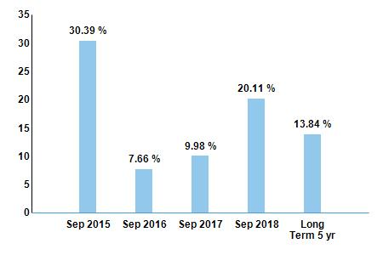
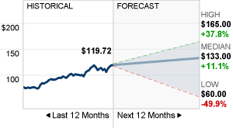
Apple Inc. Growth Forecast-Analysts (2015)
Data Provider: Data is provided by Zacks Investment Research
  http://www.nasdaq.com/symbol/aapl/earnings-growth
Different Estimates are found here
  http://finance.yahoo.com/q/ae?s=aapl
  http://markets.ft.com/research/Markets/Tearsheets/Forecasts?s=AAPL:NSQ
  http://money.cnn.com/quote/quote.html?symb=AAPL
  http://www.nasdaq.com/symbol/aapl/analyst-research
Which one should we choose?
Notes:
Up to date data can be found here
https://www.nasdaq.com/symbol/aapl/analyst-research
Like in any other case there seems to be a diverse palette of opinions with regards to the future of EPS and Share Price of Apple. If we do not have our own information set, we might need to reserve to other peoples opinions. There is no rule of thumb for choosing which one is ore reliable
To add a bit more to the debate, some more opinions can be found below
http://www.telegraph.co.uk/finance/markets/questor/11375500/Questor-share-tip-Apple-remains-a-sell.html

Slide 53
How good are analysts at forecasting growth?
Analysts forecasts of EPS tend to be closer to the actual EPS than simple time series models, but the differences tend to be small
Study Time Period Analyst Forecast Error Time Series Model
Collins & Hopwood Value Line Forecasts 31.7% 34.1%
Brown & Rozeff Value Line Forecasts 28.4% 32.2%
Fried & Givoly Earnings Forecaster 16.4% 19.8%
The advantage that analysts have over time series models
  tends to decrease with the forecast period (next quarter versus 5 years)
  tends to be greater for larger firms than for smaller firms
  tends to be greater at the industry level than at the company level
Forecasts of growth (and revisions thereof) tend to be highly correlated across analysts.
Notes:
While analyst estimates tend to be more precise than historical growth based estimates, the improvement in accuracy seems small relative to the resources expended on analysts….
Analysts also tend to move in herds… an upgrade by one often leads to upgrades by others…
The Five Deadly Sins of an Analyst
Tunnel Vision: Becoming so focused on the sector and valuations within the sector that you lose sight of the bigger picture.
Lemmingitis:Strong urge felt to change recommendations & revise earnings estimates when other analysts do the same.
Stockholm Syndrome: Refers to analysts who start identifying with the managers of the firms that they are supposed to follow.
Factophobia (generally is coupled with delusions of being a famous story teller): Tendency to base a recommendation on a “story” coupled with a refusal to face the facts.
Dr. Jekyll/Mr.Hyde: Analyst who thinks his primary job is to bring in investment banking business to the firm.
Are some analysts more equal than others?
A study of All-America Analysts (chosen by Institutional Investor) found that
There is no evidence that analysts who are chosen for the All-America Analyst team were chosen because they were better forecasters of earnings. (Their median forecast error in the quarter prior to being chosen was 30%; the median forecast error of other analysts was 28%)
However, in the calendar year following being chosen as All-America analysts, these analysts become slightly better forecasters than their less fortunate brethren. (The median forecast error for All-America analysts is 2% lower than the median forecast error for other analysts)
Earnings revisions made by All-America analysts tend to have a much greater impact on the stock price than revisions from other analysts
The recommendations made by the All America analysts have a greater impact on stock prices (3% on buys; 4.7% on sells). For these recommendations the price changes are sustained, and they continue to rise in the following period (2.4% for buys; 13.8% for the sells).
Propositions about Analyst Growth Rates
Proposition 1: There if far less private information and far more public information in most analyst forecasts than is generally claimed.
Proposition 2: The biggest source of private information for analysts remains the company itself which might explain
why there are more buy recommendations than sell recommendations (information bias and the need to preserve sources)
why there is such a high correlation across analysts forecasts and revisions
why All-America analysts become better forecasters than other analysts after they are chosen to be part of the team.
Proposition 3: There is value to knowing what analysts are forecasting as earnings growth for a firm. There is, however, danger when they agree too much (lemmingitis) and when they agree to little (in which case the information that they have is so noisy as to be useless).

Slide 54
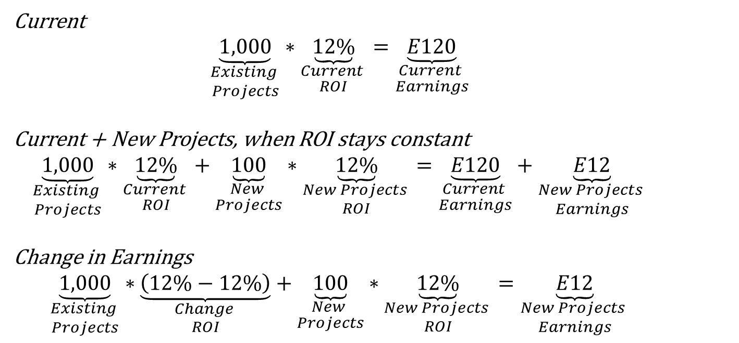
III. Fundamental Growth Rates
Assume that you have invested E1,000 in existing projects and you want to invest E100 in new projects.
Assume that ROI is 12%
Current
$$\underset{\begin{aligned}Existing \\ Projects\end{aligned}}{\underbrace{1,000}}∗\underset{\begin{aligned}Current \\ ROI\end{aligned}}{\underbrace{12\%}}=\underset{\begin{aligned}Current \\ Earnings\end{aligned}}{\underbrace{E120}}$$
Current + New Projects, when ROI stays constant
$$\underset{\begin{aligned}Existing \\ Projects\end{aligned}}{\underbrace{1,000}}∗\underset{\begin{aligned}Current \\ ROI\end{aligned}}{\underbrace{12\%}}+\underset{\begin{aligned}New \\ Projects\end{aligned}}{\underbrace{100}}∗\underset{\begin{aligned}New Projects \\ ROI\end{aligned}}{\underbrace{12\%}}=\underset{\begin{aligned}Current \\ Earnings\end{aligned}}{\underbrace{E120}}+\underset{\begin{aligned}New Projects \\ Earnings\end{aligned}}{\underbrace{E12}}$$
Change in Earnings
$$\underset{\begin{aligned}Existing \\ Projects\end{aligned}}{\underbrace{1,000}}∗\underset{\begin{aligned}Change \\ ROI\end{aligned}}{\underbrace{\left(12\%−12\%\right)}}+\underset{\begin{aligned}New \\ Projects\end{aligned}}{\underbrace{100}}∗\underset{\begin{aligned}New Projects \\ ROI\end{aligned}}{\underbrace{12\%}}=\underset{\begin{aligned}New Projects \\ Earnings\end{aligned}}{\underbrace{E12}}$$
Notes:
Simple set-up to illustrate that earnings growth comes from how much you reinvest and how well you reinvest…
Change in earnings comes from two sources:
Investment
When we invest in more projects, we can expect higher future earnings, even if the ROI stays the same. This is one way to achieve growth, by investing more (and keep return per project stable)
Change in ROI
We can achieve growth even if we do not invest more, as long as we can achieve higher ROI for (new and) existing projects. F.e. we can change a material or a supplier and achieve lower cost of goods sold. Consequently, the return on investment increases for existing projects. Earnings go up and this way we can create growt.
Combination of the two
Another way of achieving growth is by investing more on projects that can increase ROI. For example, an investment in a new, more efficient machine, will increase ROI (for existing and new projects) and the invested capital, and consequently we can expect higher earnings and thus, growth.

Slide 55
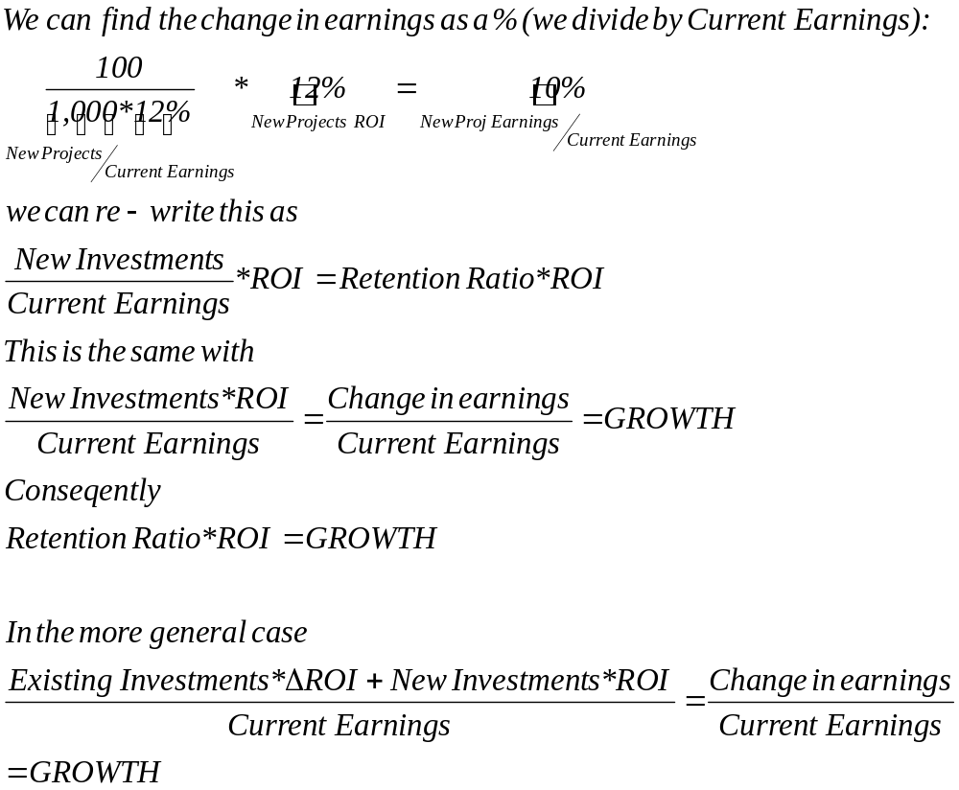
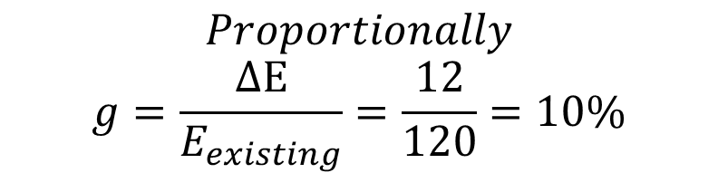
Growth Rate Derivation
$$Proportionally$$
$$g=\frac{ΔE}{E_{existing}}=\frac{12}{120}=10\%$$
Notes:
Consequently growth comes from re-investments and extra returns coming from these investments. The questions we ask are:
How much (from a measure of earnings) do we invest back?
How much do we expect to earn (based on where do the cash flows go) from these investments?
Sets up the relationship between growth in earnings and the two determinants of this growth - reinvestment rate and return on equity.
Opens the door to the second source of earnings growth - improvement in returns on assets in place.
The last formula shows how we can find the growth rate when there is an improvement in ROI and future investments. For example, assume that ROI increases to 13%. Then the growth rate is:
g={1,000*(13%-12%)+100*13%} / {1,000*12%)=23/120=19.17%

Slide 56
Intrinsic Growth: General
Growth comes from quality and magnitude of investments
$$g=$$
$$\overset{\begin{aligned}R: \\ Return \\ (Quality)\end{aligned}}{\overbrace{R}}∗\underset{\begin{aligned}RR: \\ Re−Investment \\ (Magnitude)\end{aligned}}{\underbrace{RR}}$$
𝑔=
⏞𝑅┴█(𝑅:@𝑅𝑒𝑡𝑢𝑟𝑛@(𝑄𝑢𝑎𝑙𝑖𝑡𝑦))∗⏟𝑅𝑅┬█(𝑅𝑅:@𝑅𝑒−𝐼𝑛𝑣𝑒𝑠𝑡𝑚𝑒𝑛𝑡@(𝑀𝑎𝑔𝑛𝑖𝑡𝑢𝑑𝑒))
The magnitude of investments should be inline with growth
$$RR=\frac{R}{g}$$
𝑅𝑅=𝑅/𝑔
You cannot expect growth unless your return reaches a certain level
$$R=\frac{RR}{g}$$
𝑅=𝑅𝑅/𝑔

Slide 57

Estimate Growth
Dividends
Net Income
EBIT
Retention Ratio*ROE
Eq-Re-investment
Rate*ROE
Re-investment Rate*ROC
Notes:
This is something that you need to remember
When we want to estimate the growth of earnings (and part of earnings=dividends), part of earnings is re-invested (Retention Ratio, RR) and can earn a return (ROE), which refers only to equity.
In contrast, when we take into account FCFF, the starting point is EBIT. Thus, we need to estimate a growth rate for EBIT. The question here is, how much do we invest from available EBIT (Re-investment Ratio) and the return we can expect refers to both equity and debt and is ROC
When are we supposed to use either of them.
When we contact a dividend valuation we need the growth in EPS. However, this assumes that the maximum re-investment is the available income (EPS), without debt being considered as an option. However, there are firms that can and want to invest more than the available income and thus, they borrow. In this case we should probably consider the growth of NI (as a whole) rather than per share (EPS). Finally, both approaches above consider stable financing and/or positive net income. If we cannot assume either, then we d better contact a FCFF valuation and for this we need to estimate growth of EBIT.

Slide 58
I. Expected Long Term Growth in EPS
When looking at growth in earnings per share, these inputs can be cast as follows:
Reinvestment Rate = Retained Earnings/ Current Earnings = Retention Ratio
Return on Investment = ROE = Net Income/Book Value of Equity
In the special case where the current ROE is expected to remain unchanged
g_{EPS} = Retained Earnings_{t-1}/ NI_{t-1} * ROE
= Retention Ratio * ROE
= RR * ROE
Proposition 1: The expected growth rate in earnings for a company cannot exceed its return on equity in the long term.
Notes:
In an equity analysis, the return on investment becomes return on equity and the reinvestment rate is measured as the percent of net income that gets reinvested back into the firm (which is the retention ratio).
Proposition 1 should have the caveat that this applies because the return on equity on existing assets cannot keep going up each year in the long term….

Slide 59
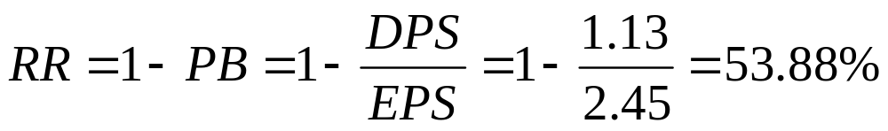
Expected Growth Rate ABN Amro
Current Return on Equity = 15.79%
DPS=1.13, EPS=2.45
If ABN Amro can maintain its current ROE and retention ratio, its expected growth in EPS will be:
Notes:
Implicitly, we are assuming that the current return on equity applies not only to existing investments but to marginal investments as well… In this case, the expected growth in earnings per share will be 8.51%.

Slide 60
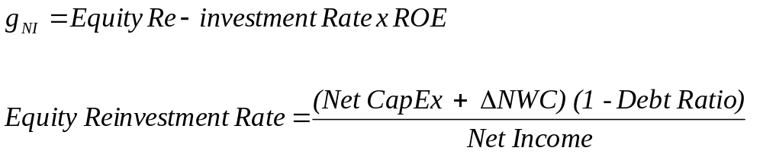
II. Expected Growth in Net Income
The limitation of the EPS fundamental growth equation is that it focuses on per share earnings and assumes that reinvested earnings are invested in projects earning the return on equity.
A more general version of expected growth in earnings can be obtained by substituting in the equity reinvestment into real investments (net capital expenditures and working capital):
Firm can issue equity to finance projects
Notes:
While earnings per share cannot grow faster than the return on equity, net income can, if the firm goes out and raises additional equity to expand. In such a scenario, the equity reinvestment rate can be higher than 100%.
If you are forecasting net income, you should probably use this approach, rather than the more conventional growth equation.
The idea is still the same. We have net income. Part of it will be re-invested.
Remember that FCFE=NI-(ΔCapEx+ΔNWC)*(1-δ).
(ΔCapEx+ΔNWC)*(1-δ) is the part of NI that is re-invested
We call the ratio ((ΔCapEx+ΔNWC)*(1-δ)) / NI Equity Re-investment Rate
Growth comes from how much we re-invest (ERR) and Return on these investments (still refers only to equity (NI), ROE)

Slide 61
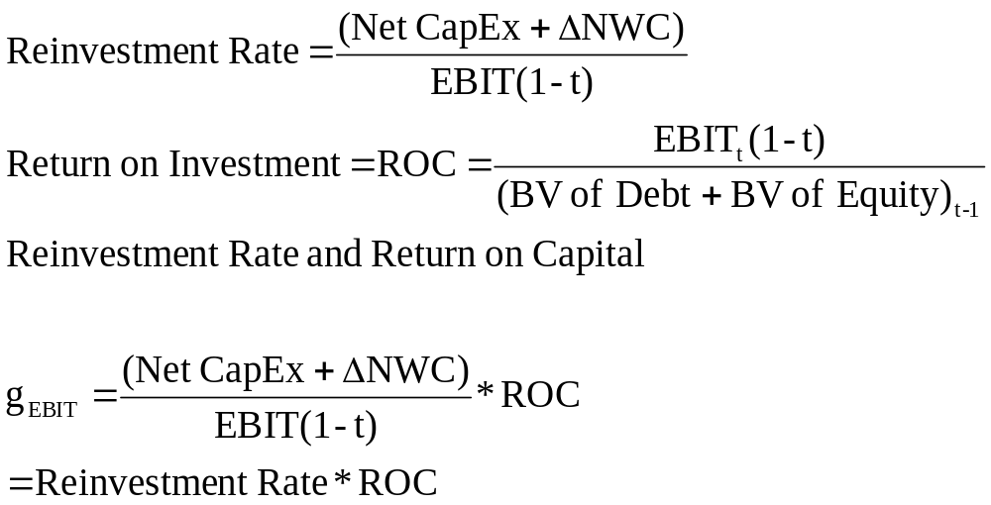
III. Expected Growth in EBIT And Fundamentals: Stable ROC and Reinvestment Rate
Proposition: The net capital expenditure needs of a firm, for a given growth rate, should be inversely proportional to the quality of its investments.
Notes:
When looking at free cash flows to the firm and operating income, you need to define reinvestment rates and returns consistently. The reinvestment rate is stated as a percent of after-tax operating income (rather than net income) and the return is the return on capital(rather than return on equity).
Still the same. Growth comes from re-investment and return.
g=reinvestment rate*return
The difference is that we are interested in FCFF.
Remember FCFF=EBIT(1-T)-(ΔCapEx+ΔNWC)
(ΔCapEx+ΔNWC) is the part of EBIT*(1-T) that we re-invest
We call the ratio (ΔCapEx+ΔNWC)/EBIT*(1-T) Re-investment rate
The return we need refers to both equity and bond holders. Therefore we need ROC
Consequently, g=Re-investment Rate*ROC
Some Examples
Cisco’s Fundamentals
Reinvestment Rate = 106.81%
Return on Capital =34.07%
Expected Growth in EBIT =(1.0681)(.3407) = 36.39%
Motorola’s Fundamentals
Reinvestment Rate = 52.99%
Return on Capital = 12.18%
Expected Growth in EBIT = (.5299)(.1218) = 6.45%
Growth is earned. Cisco had a high growth because it reinvested a lot and reinvested well. Motorola had a low growth rate because it reinvested less and earned a much lower return on capital.

Slide 62
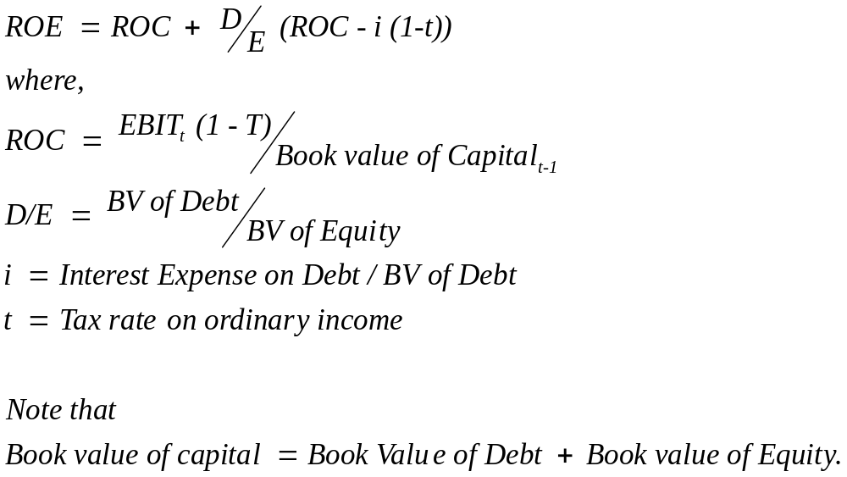
ROE and Leverage
Notes:
Companies can end up with high returns on equity either because they take great projects (high ROC) or use a lot of leverage….
Everything has to be done in book value terms, because both ROE and ROC are based on on book value… This is because market value includes expected future growth potential and cannot be used as the denominator in computing the return on equity or capital… it is not fair to ask companies to earn returns on projects they have not taken yet.

Slide 63
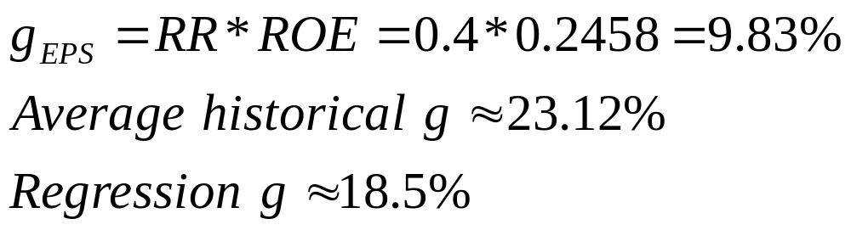
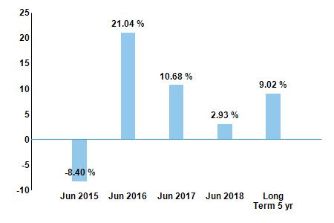
EPS Growth Rate Microsoft
(2015)
Average RR≈0.4
EPS =$2.63 and DPS=$1.07
ROE=NI/Equity= $22,074m /$89,784m=24.58%
Notes:
Disclaimer: This is the estimate for 2014-5. The data source and discussion is given below. Go to Nasdaq and try to estimate the rate yourselves.
Source
http://www.nasdaq.com/symbol/dis/financials?query=income-statement
There are plenty of estimates for growth of EPS. The final input on the valuation model needs to be our own estimate. It could be our personal opinion (disregarding all these), it might be based on inside information or intuition, it might be an average of all these, it might be closer to a source because we trust it more etc. etc. etc.

Slide 64
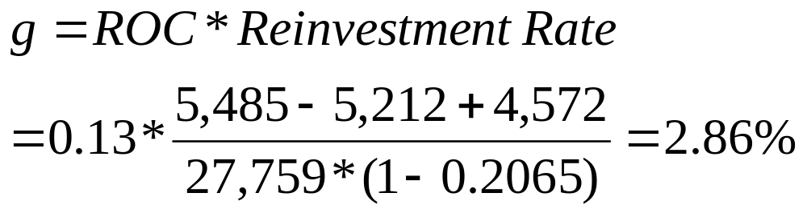
Growth EBIT
$m | 2014 | 2013 | 2012
EBIT | 27,759 | 26,764 | 21,763
Depreciation | 5,212 | 3,755 | 2,967
CapEx | 5,485 | 4,257 | 2,305
ΔNWC | 4,572 | 11,653 | 6,252
ROC | 0.127 | 0.1304 | 0.134
Average ROC is around 13%
Probably the slow down in EBIT comes from the decreased Re-investment, especially in NWC
Notes:
Source
http://www.nasdaq.com/symbol/msft/financials?query=balance-sheet
The effective tax rate is (5,746/27,820)=20.65%

Slide 65
Appendix
Money Loosing Firm
Example Operating Leases
Example R&D Capitalization

Slide 66
IV. Estimating Growth when Operating Income is Negative or Margins are changing
Step 1: Estimate growth rates in revenues over time
Use historical revenue growth to get estimates of revenue growth in the near future
Decrease the growth rate as the firm becomes larger
Keep track of absolute revenues to make sure that the growth is feasible
Step 2: Estimate expected operating margins each year
Set a target margin that the firm will move towards
Adjust the current margin towards the target margin
Step 3: Estimate the capital that needs to be invested to generate revenue growth and expected margins
Estimate a sales to capital ratio that you will use to generate reinvestment needs each year.
Notes:
When a firm has negative operating income and low revenues, the sequence changes. Instead of assuming a reinvestment rate and return on capital first, and obtaining growth from these inputs, you should consider estimating revenue growth first and then asking what you would need to reinvest to generate this revenue growth. In conjunction, you will need to assume that your margins will improve over time towards stable (and positive) levels.

Slide 67
Negative Operating Margin-Commerce One
Commerce One has had some bad years, where negative operating profit was established.
However, the management of the company has changed and now investors believe that it could become again a healthy company (Industry Avg)
They assume the following changes
The current financials are summarized bellow
 | 1 | 2 | 3 | 4 | 5 | 6 | 7 | 8 | 9 | 10
%ΔSales | 50 | 100 | 80 | 60 | 40 | 35 | 30 | 20 | 10 | 5
Op Margin | -48.17 | -27.21 | -13.23 | -3.91 | 2.30 | 6.44 | 9.20 | 11.04 | 12.27 | 13.08
Sales | 537 | Ind Tax | 30%
Op Margin | -79.62% | Ind NCE/Sales | 8.76%
Capital | $2,744 | Ind NWC/Sales | 3.31%
Ind ROC | 16%

Slide 68

Commerce One: Revenues and Revenue Growth
Year | Growth | Rev | OPM | EBIT
0 |  | $ 537.00
1 | 50% | $ 806.00 | -48% | $ -388.25
2 | 100% | $ 1,611.00 | -27% | $ -438.35
3 | 80% | $ 2,900.00 | -13% | $ -383.67
4 | 60% | $ 4,640.00 | -4% | $ -181.42
5 | 40% | $ 6,496.00 | 2% | $ 149.41
6 | 35% | $ 8,770.00 | 6% | $ 564.79
7 | 30% | $11,401.00 | 9% | $1,048.89
8 | 20% | $13,681.00 | 11% | $1,510.38
9 | 10% | $15,049.00 | 12% | $1,846.51
10 | 5% | $15,802.00 | 13% | $2,066.90
Notes:
The growth rate in year 1 was set lower to reflect the fact that the economy had slowed down at the time of this forecast. As Commerce One gets larger, revenue growth rates become smaller. The initial year’s estimates were based upon looking at the recent past. We estimated the expected revenues in 10 years first (by making assumptions about market share and total market size) and then adjusted the growth rate in the intermediate years to get to these revenues. (Making year-to-year estimates becomes just about impossible with firms like these…)

Slide 69
Commerce One: Reinvestment Needs
 | Rev ($) | EBIT ($) | Tax | NCE /Sales | NCE ($) | WC /Sales | NWC ($) | Inv ($) | FCFF
0 | 537
1 | 806 | -388.25 | 30% | 8.76% | 70.61 | 3.31% | 8.90 | 79.51 | $ -467.76
2 | 1611 | -438.35 | 30% | 8.76% | 141.12 | 3.31% | 26.65 | 167.77 | $ -606.12
3 | 2900 | -383.67 | 30% | 8.76% | 254.04 | 3.31% | 42.67 | 296.71 | $ -680.38
4 | 4640 | -181.42 | 30% | 8.76% | 406.46 | 3.31% | 57.59 | 464.06 | $ -645.48
5 | 6496 | 149.41 | 30% | 8.76% | 569.05 | 3.31% | 61.43 | 630.48 | $ -525.90
6 | 8770 | 564.79 | 30% | 8.76% | 768.25 | 3.31% | 75.27 | 843.52 | $ -448.17
7 | 11401 | 1048.89 | 30% | 8.76% | 998.73 | 3.31% | 87.09 | 1085.81 | $ -351.59
8 | 13681 | 1510.38 | 30% | 8.76% | 1198.46 | 3.31% | 75.47 | 1273.92 | $ -216.66
9 | 15049 | 1846.51 | 30% | 8.76% | 1318.29 | 3.31% | 45.28 | 1363.57 | $ -71.01
10 | 15802 | 2066.90 | 30% | 8.76% | 1384.26 | 3.31% | 24.92 | 1409.18 | $ 37.65

Slide 70

Money Loosing Firm: Case Study

Slide 71
Operating Leases-Example
The Gap has EBIT equal to $1.012b, conventional debt of about $ 1.97 billion on its balance sheet and its pre-tax (35%) cost of debt is about 6%. Its operating lease payments for the previous year were $978m and its commitments for the future are below:
Year Commitment (millions)
1 $899.00
2 $846.00
3 $738.00
4 $598.00
5 $477.00
6&7 $982.50 each year
Other figures for GAP include
What is the Adjusted Operating Income?
MV of Debt=BV Debt | $1,970m
BV of Equity | $3,130m
MV of Equity | $7,350m
ke | 8.2%

Slide 72
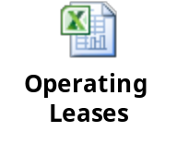
Operating Leases at The Gap
Year Commitment (millions) Present Value (at 6%)
1 $899.00 $848.11
2 $846.00 $752.94
3 $738.00 $619.64
4 $598.00 $473.67
5 $477.00 $356.44
6&7 $982.50 each year $1,346.04
Debt Value of leases = $4,396.85 (Also value of leased asset)
Debt outstanding at The Gap = $1,970 m + $4,397 m = $6,367 m
Adjusted Operating Income = Stated OI + OL exp this year - Deprec’n
= $1,012 m + 978 m - 4397 m /7 = $1,362 million (7 year life for assets)
Approximate OI = $1,012 m + $ 4397 m (.06) = $1,276 m
Notes:
The Gap reports its lease commitments in its financial statements. The present value of operating lease expenses is computed using the pre-tax cost of debt. (An argument can be made that the unsecured cost of debt should be used.)

Slide 73
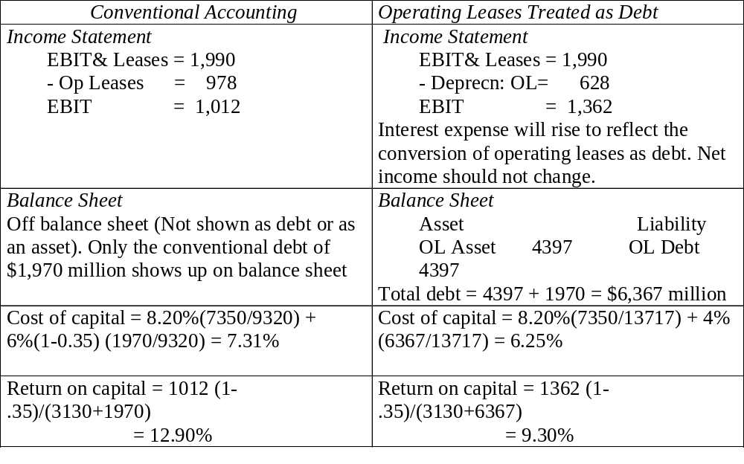
The Collateral Effects of Treating Operating Leases as Debt
Notes:
Traces the effect of converting operating leases to debt. Both operating income and capital invested increase. The net effect on return on capital will depend upon which increases more.

Slide 74
Capitalizing R&D Expenses: Cisco
Cisco is a company that invests for high growth and part of its investments are in R & D, which is assumed to have a 5-year life.
Year R&D Expense
2013 (current) 1594.00
2012 1026.00
2011 698.00
2010 399.00
2009 211.00
2008 89.00
What is the adjustment in operating income?
Other figures include |  | EBIT | $3,455m
Debt | 0 | MV Equity | $11,722m
Tax | 35% | CapEx | $98m
Notes:
The amortizable life is an assumption based upon Cisco’s business (telecom equipment and software). It would be shorter in other businesses (such as computer chips) and longer in businesses that need regulatory approval (such as pharmaceuticals).
Note that the amortization is 1/5 of the R&D expense each year.
We are also assuming that R&D expenses are spent at the end of each year - not realistic, but simplifies analysis - that is why there is no amortization of the current year’s expense.
The effect of capitalizing R&D will be greatest at firms where R&D is growing over time and be non-existent at firms with flat R&D.

Slide 75
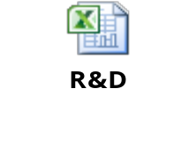
Capitalizing R&D Expenses: Cisco
R & D was assumed to have a 5-year life.
Year R&D Expense Unamortized portion Amortization this year A B A*B 0.2*A
2013 (current) 1594.00 1.00 1594.00
2012 1026.00 0.80 820.80 $205.20
2011 698.00 0.60 418.80 $139.60
2010 399.00 0.40 159.60 $79.80
2009 211.00 0.20 42.20 $42.20
2008 89.00 0.00 0.00 $17.80
Total $ 3,035.40 $ 484.60
Value of research asset = $ 3,035.4 million
Amortization of research asset in 2013 = $ 484.6 million
Adjustment to Operating Income = $ 1,594 million - 484.6 million = 1,109.4 million
Notes:
The amortizable life is an assumption based upon Cisco’s business (telecom equipment and software). It would be shorter in other businesses (such as computer chips) and longer in businesses that need regulatory approval (such as pharmaceuticals).
Note that the amortization is 1/5 of the R&D expense each year.
We are also assuming that R&D expenses are spent at the end of each year - not realistic, but simplifies analysis - that is why there is no amortization of the current year’s expense.
The effect of capitalizing R&D will be greatest at firms where R&D is growing over time and be non-existent at firms with flat R&D.

Slide 76
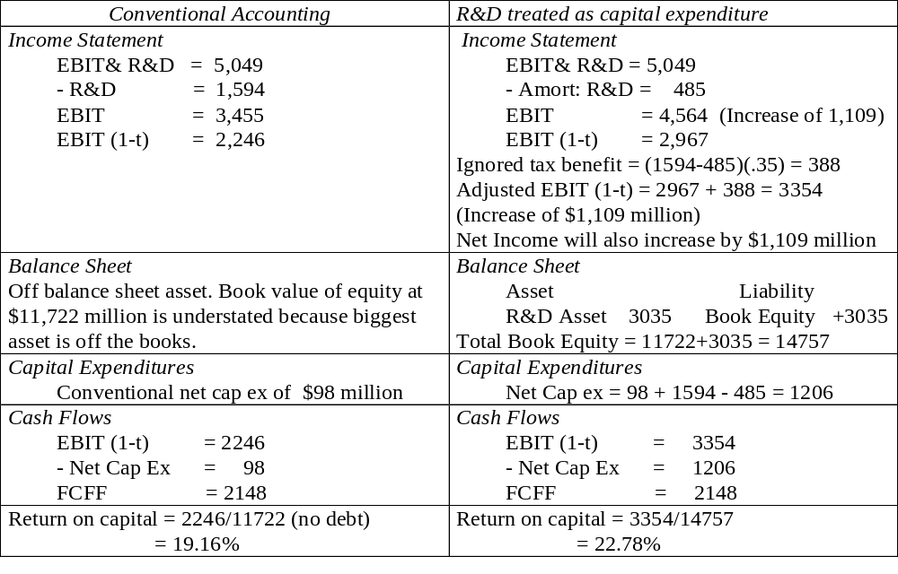
The Effect of Capitalizing R&D
Notes:
Traces out the effects of capitalizing R&D. The key aspect is that operating income will be increased by exactly the same amount that net capital expenditures will be increased, with the increase being:
Change in operating income and net cap ex = Current year’s R&D expense - R&D amortization
In other words, the free cashflow to the firm will not change as a result of this capitalization. So why do it? It allows us to
Get a better sense of the profitability of the firm (operating income and return on capital.
Better estimate how much the firm is reinvesting for future growth.

Slide 77
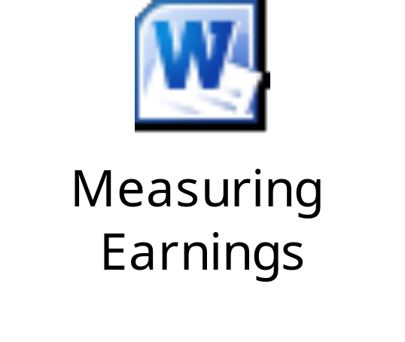

Further Practice Questions

